Slide 1
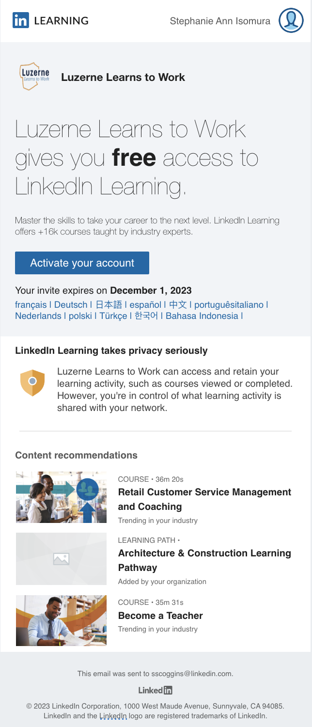
Subject:
“Stephanie, activate your LinkedIn Learning account”
Email address:
messages-noreply@linkedin.com
Expiration date:
Your activation link will expire after 30 days, indicated on your email
Notes:
Hi there!
Let's walk through how you, as a Student in the Luzerne Learns to Work program activate and access your LinkedIn Learning Account. We'll cover step by step how to activate from receiving your initial email to going through the specific steps.
As you register for your resources with LLW, you should have received an activation email from LinkedIn Learning which includes your link to activate your profile. This email can occasionally end up in a junk/spam folder, so check there if you know you've been given access but haven't received it. The emails are sent almost immediately after you've been granted access to the learning account.
Here's some points to look out for:
Subject:
“Stephanie, activate your LinkedIn Learning account”
Email address:
messages-noreply@linkedin.com
Expiration date:
Your activation link will expire after 30 days, indicated on your email

Slide 2
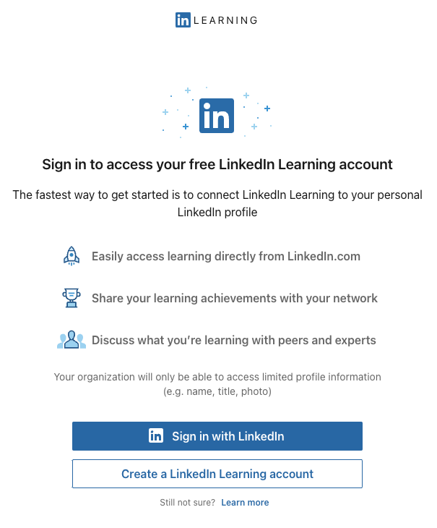
Notes:
Next step - now that we have our Email ready, find the blue Activate your Account button.
Clicking this should open a browser window to the next steps of the activation process, shown here. Prior to this step, you should have created your LinkedIn profile - remember your login information for your profile, those will be the same login details you'll use to login to LinkedIn Learning.

Slide 3
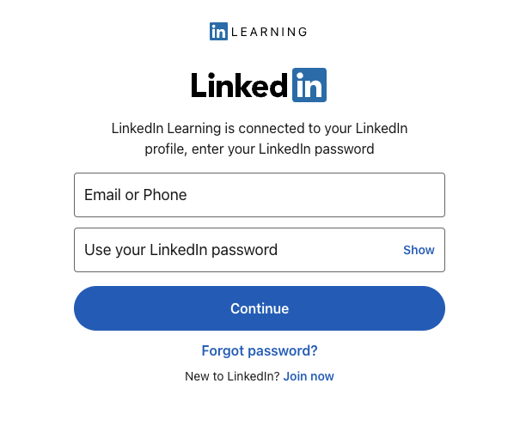
Notes:
You'll then select the blue Sign in with LinkedIn, which will connect your Profile to your Learning account. This is where it's important to remember the password your created for your LinkedIn profile.
Your username will be the email address you have on your LinkedIn profile as well.
Once you enter your login details, you'll be taken to your Learning homepage.

